Slide 1
Recent numerical results related to neuronal network simulation
Kyle Chen Jan. 8, 2018

Slide 2
In general
Use delayed mutual information to investigate the causal relationship between spike train and local field potential(LFP)
Data was generated by conductance-based integrate-and-fire neuronal network;
Spike train was a sequence of binary value with specific timing step;
The summation of neuronal membrane current was treated as the LFP in my work;

Slide 3
Paradigm of simulation
Poisson Driving Rate | 1.5 kHz
Synaptic Strength | 0.005 (changing during test)
Feedforward Strength | 0.005
Total time duration | 600 s
Number of bins of histogram calculation | Variable
1
2

Slide 4
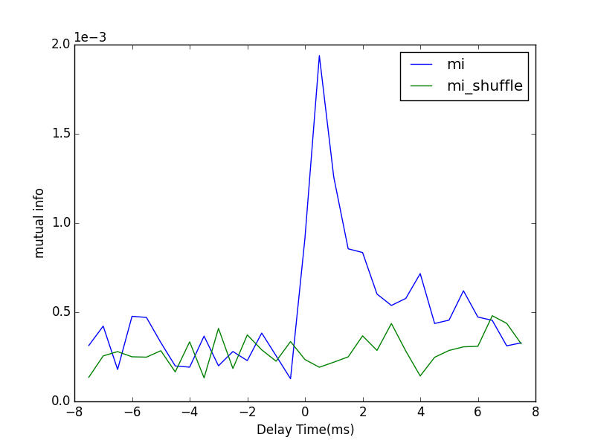
Sample Figure
The peak lying on the positive side of the graph indicates the same direction of neuronal information as the physical connection does.
dt = 0.5 ms
#bins = 20
T = 59.5 s

Slide 5
Comparison between three strategy to calculate mutual information

Slide 6
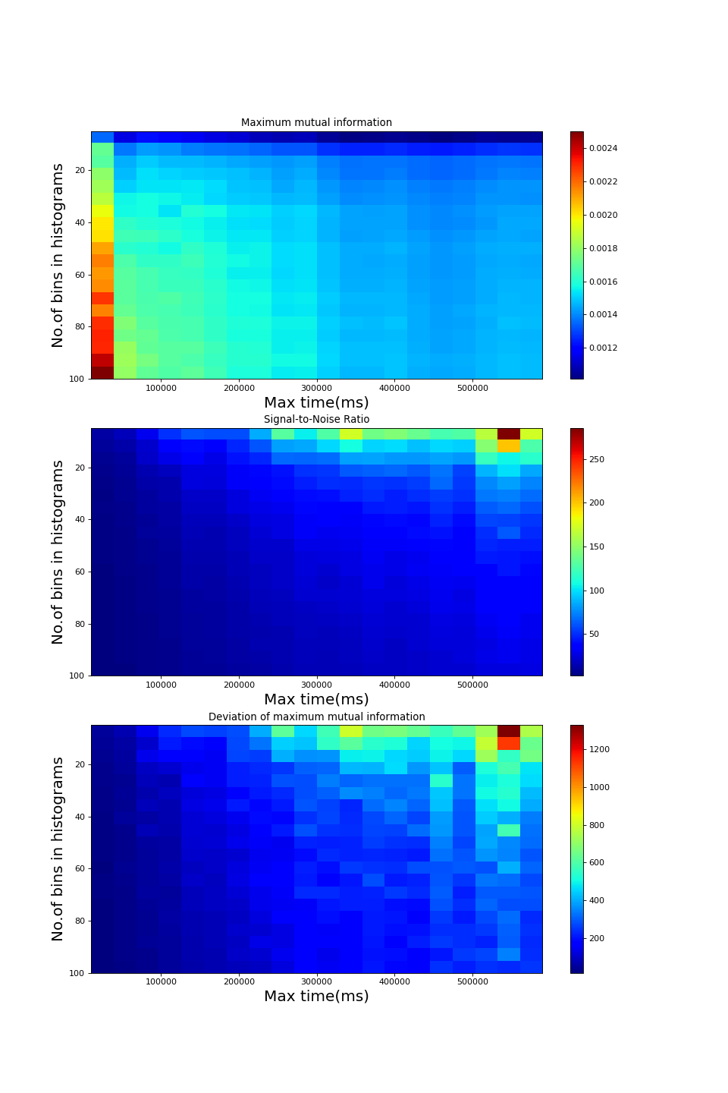
Direct calculation
Treated time series of LFP as WSS signal.
Neglect the autocovariance length of LFP.
dt = 0.5 ms

Slide 7
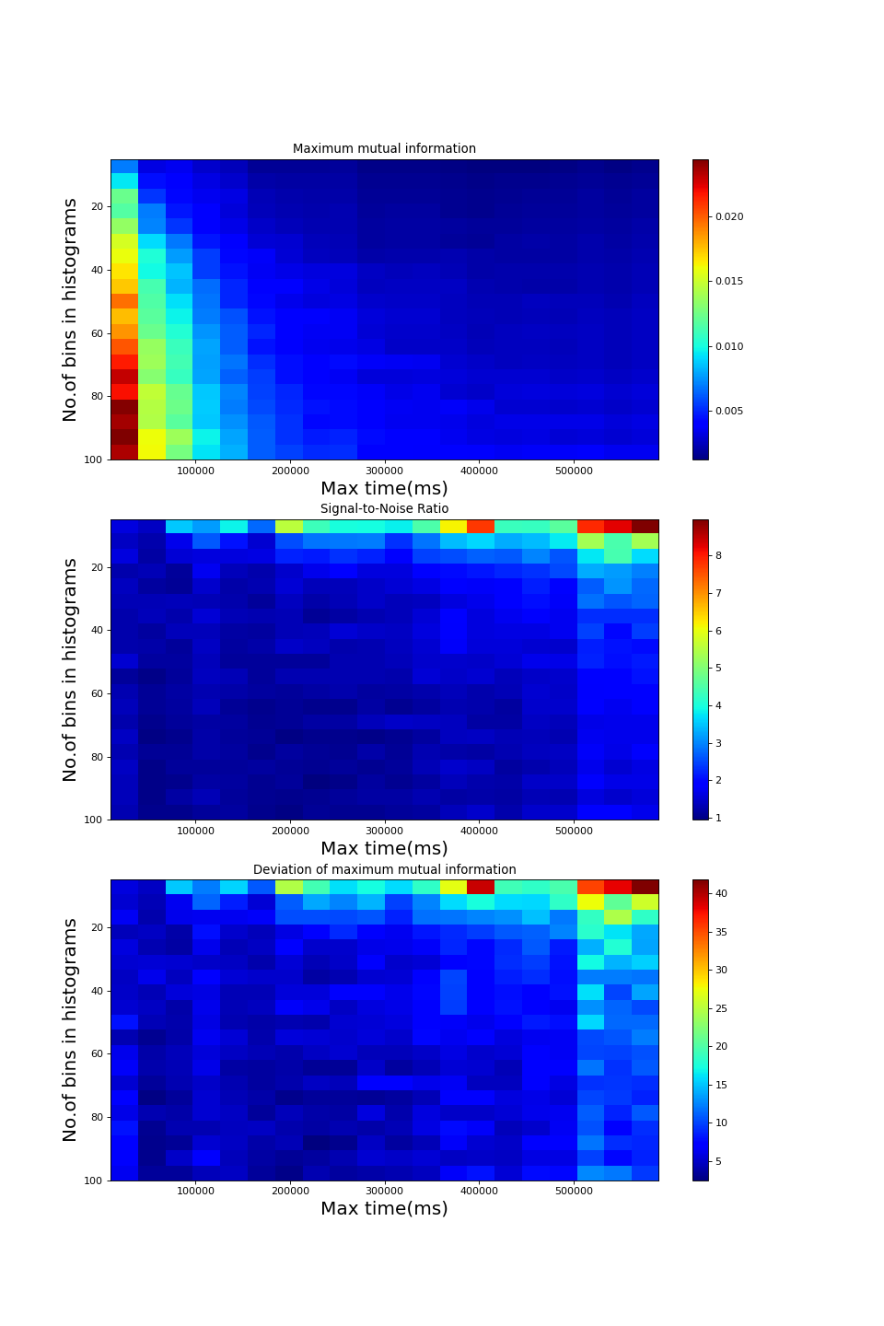
Autocovariance-based calculation without average
Find the autocovariance length of LFP, which is 20 ms here.
Break time series of LFP in pieces with length 20 ms, and treat all those pieces as a statistical ensemble.
Calculate the PDF at every time point in such 20 ms.
Do the same operates to the time series of binarized spike trains
Randomly pick one time point within 20 ms for the spike train, and calculate the TDMI between the spike train at this time point and LFP at other time points
dt = 0.5 ms
Index of spike train = 21

Slide 8
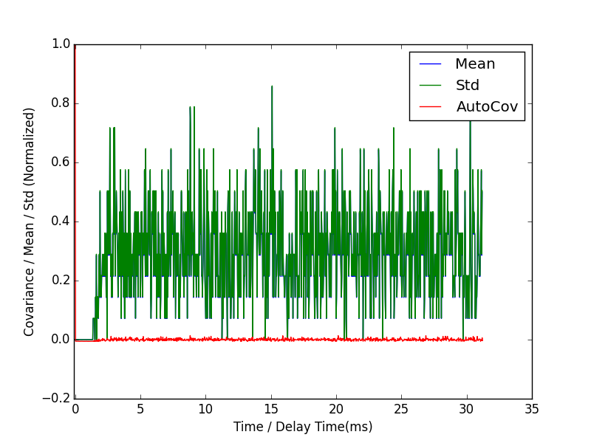
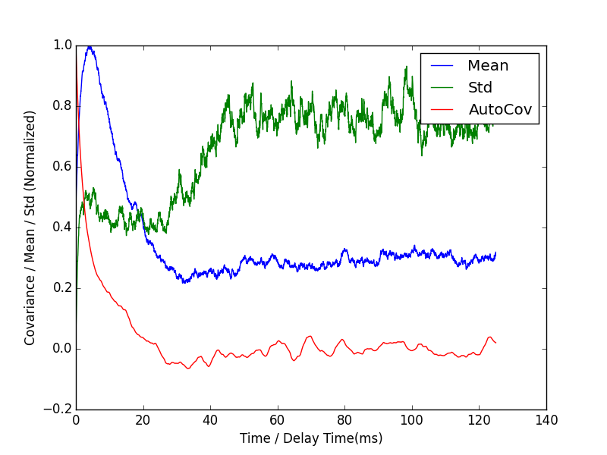
Details in mutual info measurements
S = 0.0050
Autocovariance of spike train of Neuron 1
Autocovariance of LFP of Neuron 1

Slide 9
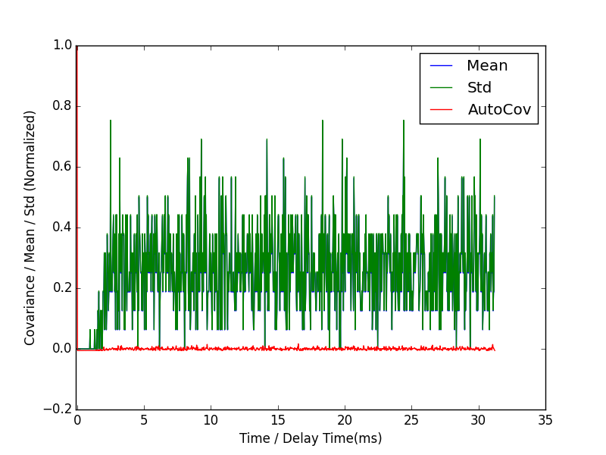
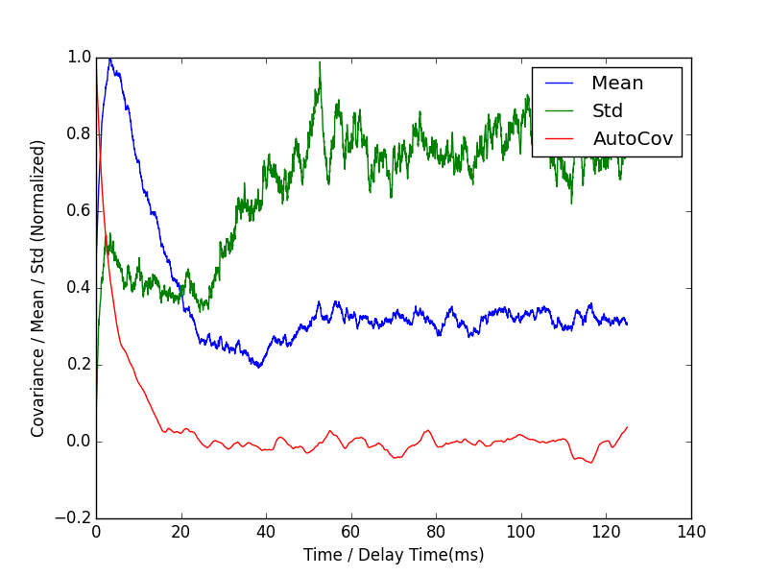
Details in mutual info measurements
S = 0.0145
Autocovariance of spike train of Neuron 1
Autocovariance of LFP of Neuron 1

Slide 10
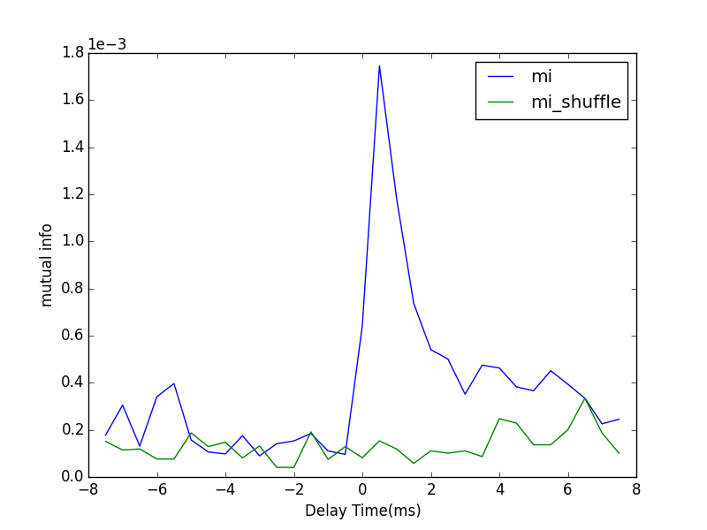
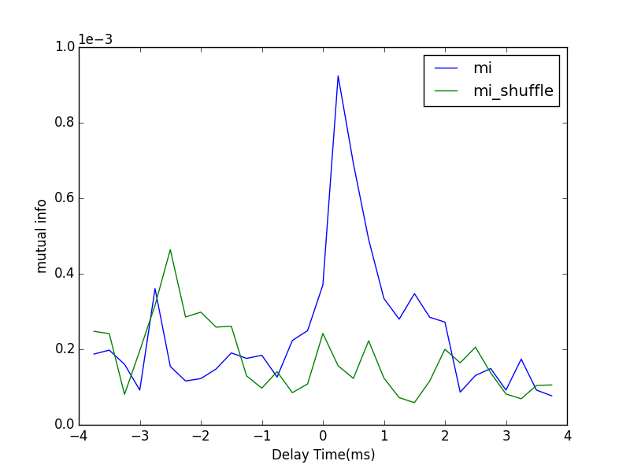
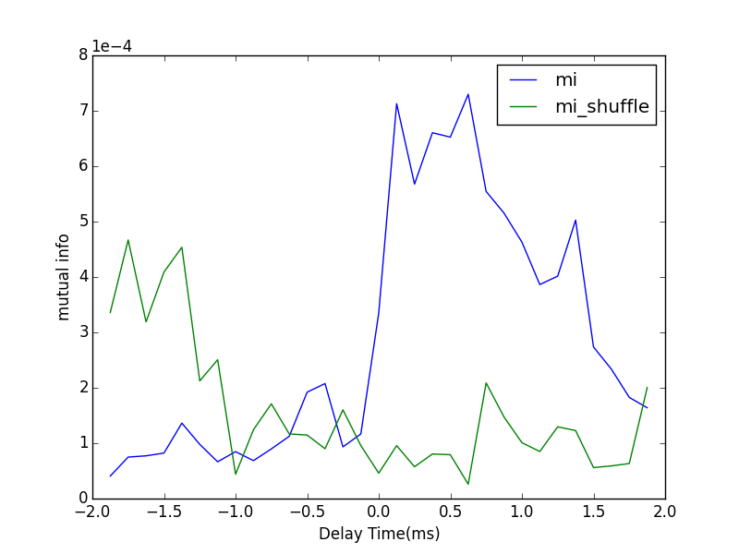
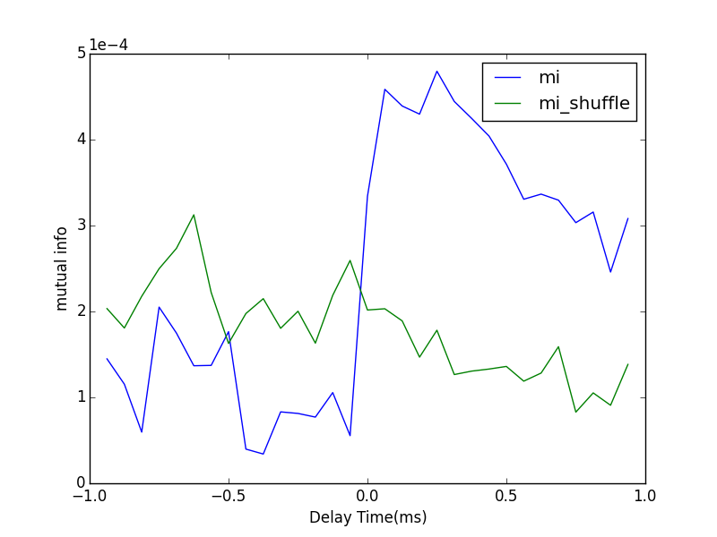
Different Timing Steps
0.5ms
0.25ms
Poisson Rate | 1.5 kHz
S | 0.005
F | 0.005
#bins | 10
T | 59.5 s
0.0625ms
0.125ms

Slide 11
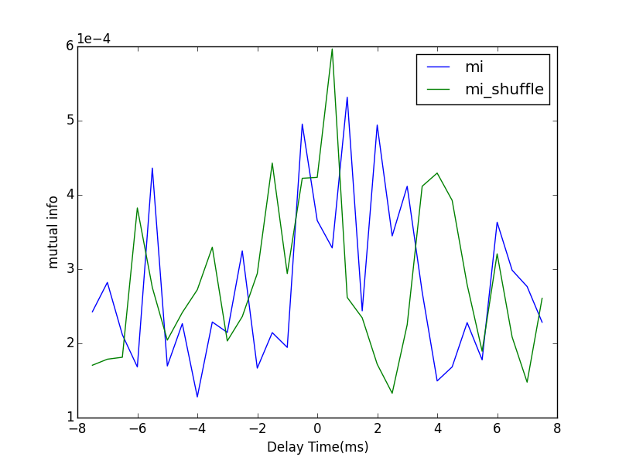
Mono-direction
Poisson Rate | 1.5 kHz
S | 0.005
F | 0.005
dt | 0.5 ms
#bins | 20
T | 59.5 s
From 1 to 2
From 2 to 1

Slide 12
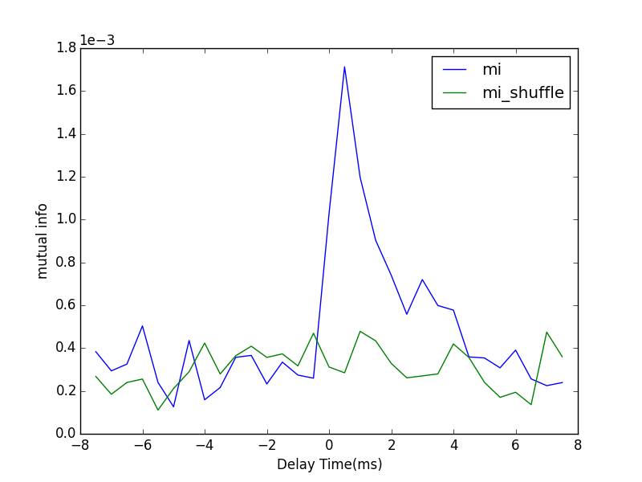
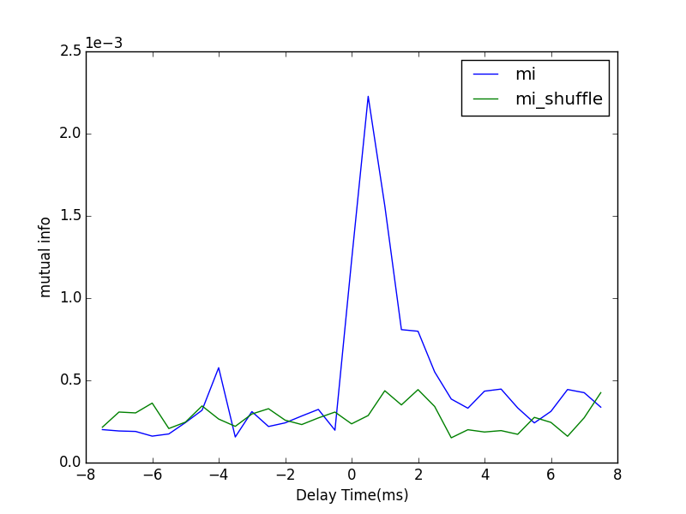
Bi-direction
Poisson Rate | 1.5 kHz
S | 0.005
F | 0.005
dt | 0.5 ms
#bins | 20
T | 59.5 s
From 1 to 2
From 2 to 1

Slide 13
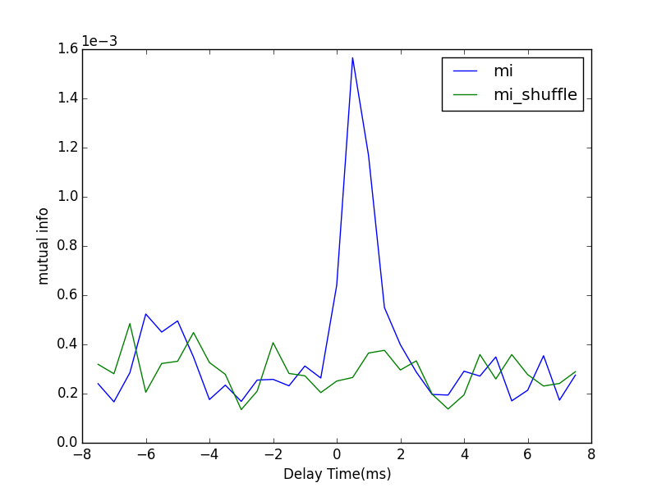
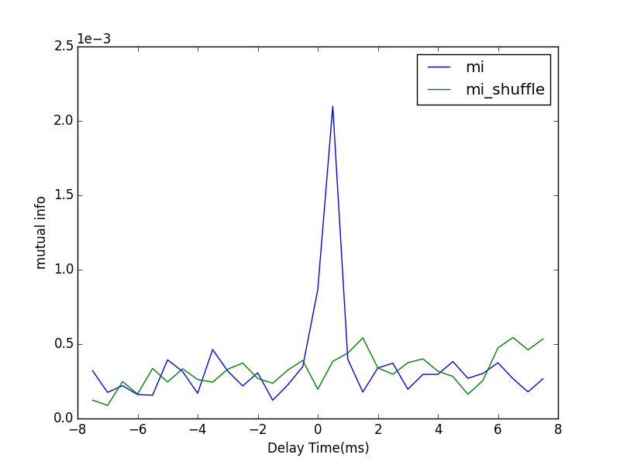
Robustness
Fix the product of Poisson driving rate and feedforward strength. Change the Poisson driving rate and investigate the change of mutual information pattern
1.5 kHz
0.5 kHz
0.1 kHz
dt | 0.5 ms
#bins | 30
T | 59.5 s

Slide 14
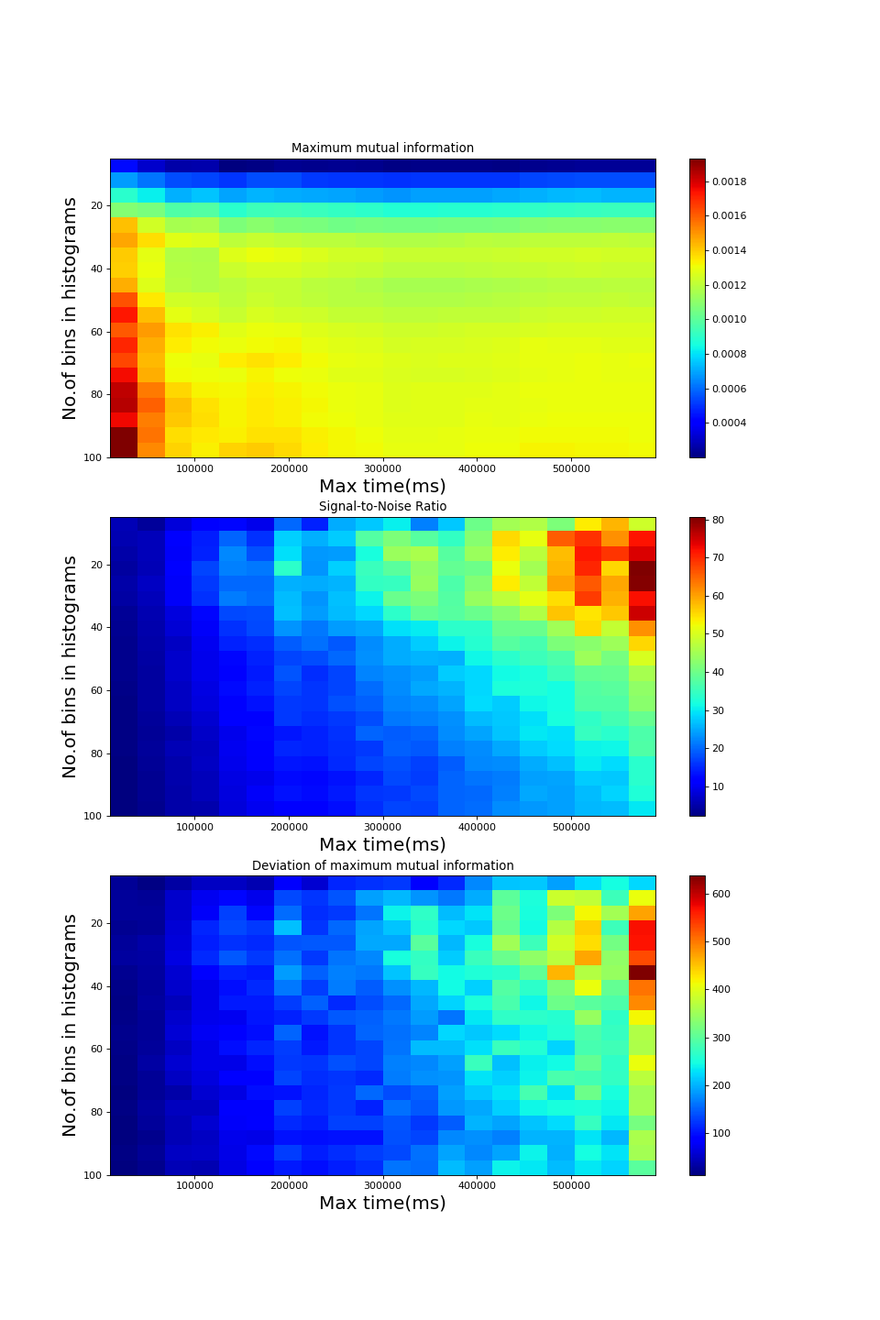
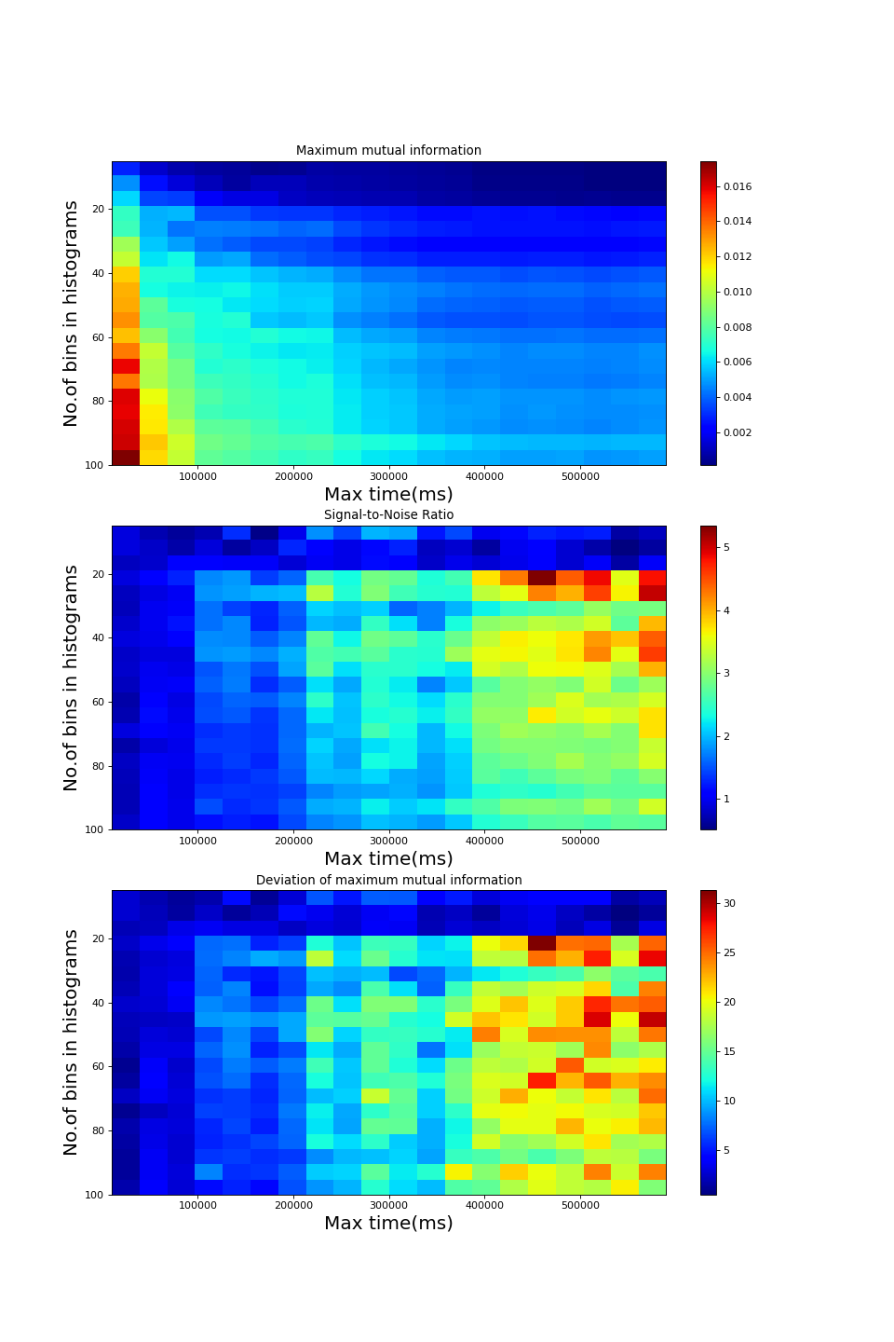
Full method
S = 0.015
S = 0.075

Slide 15
partial method
S = 0.015
S = 0.075

Slide 16
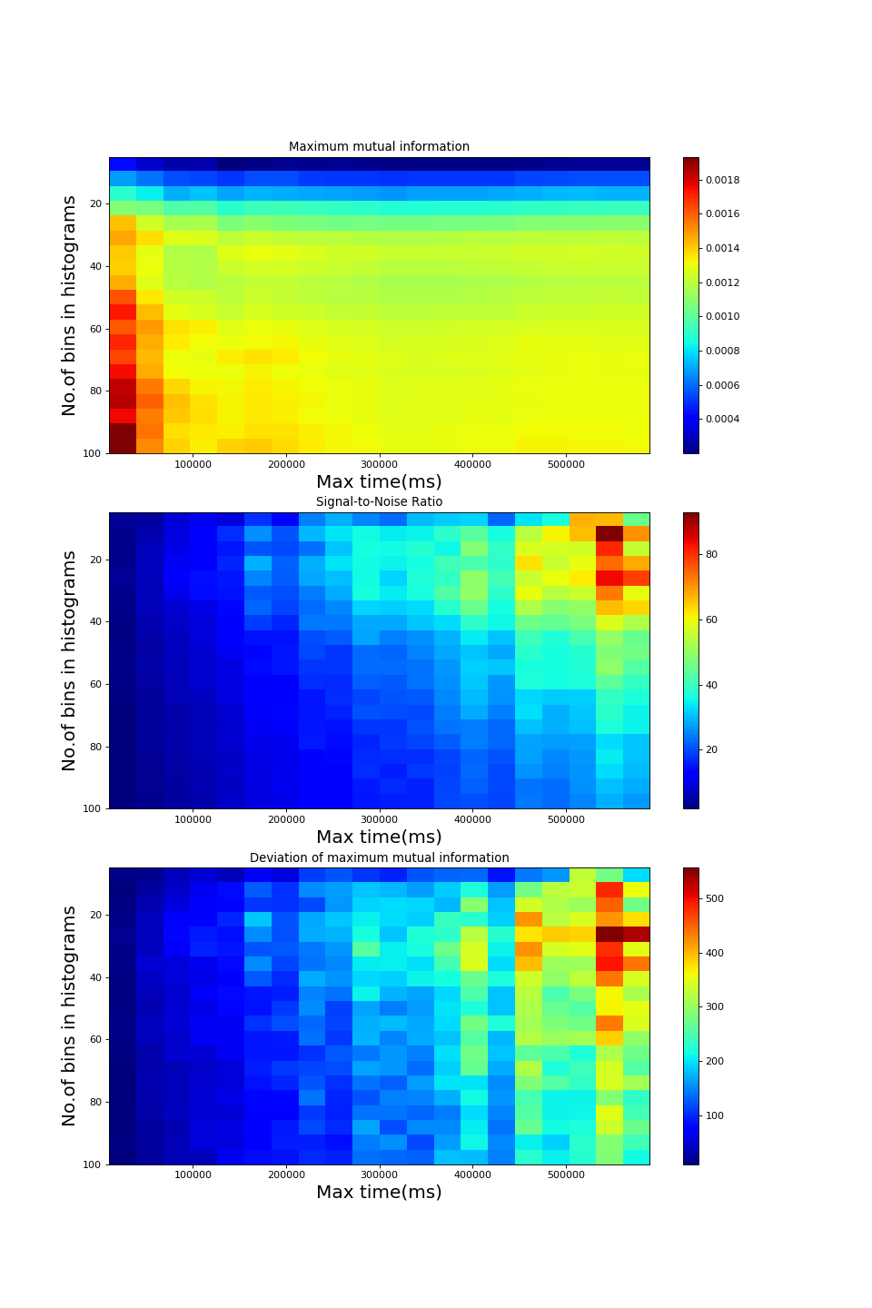
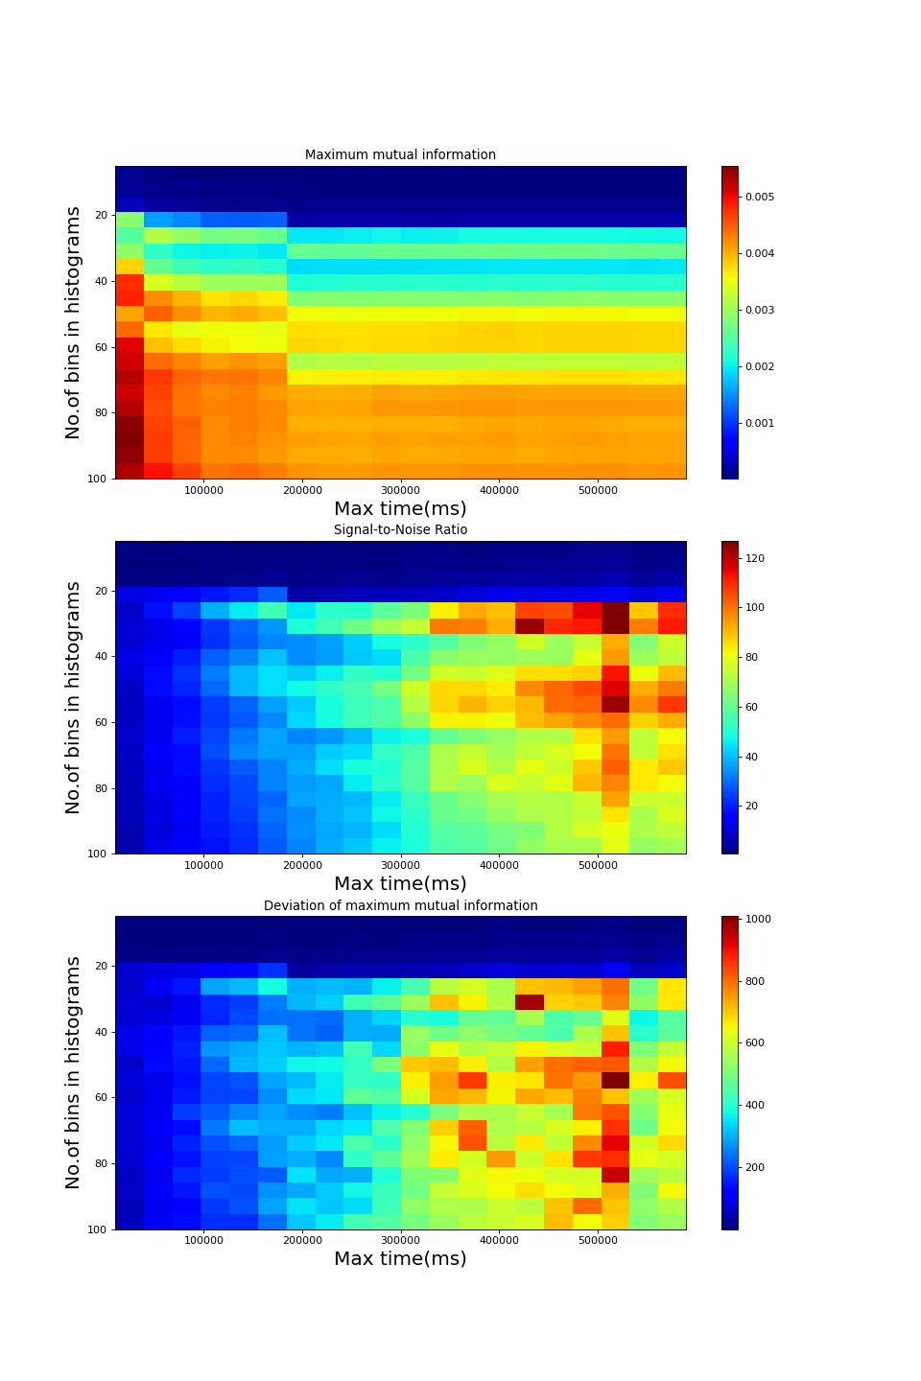
Direct method
S = 0.015
S = 0.075

Slide 17
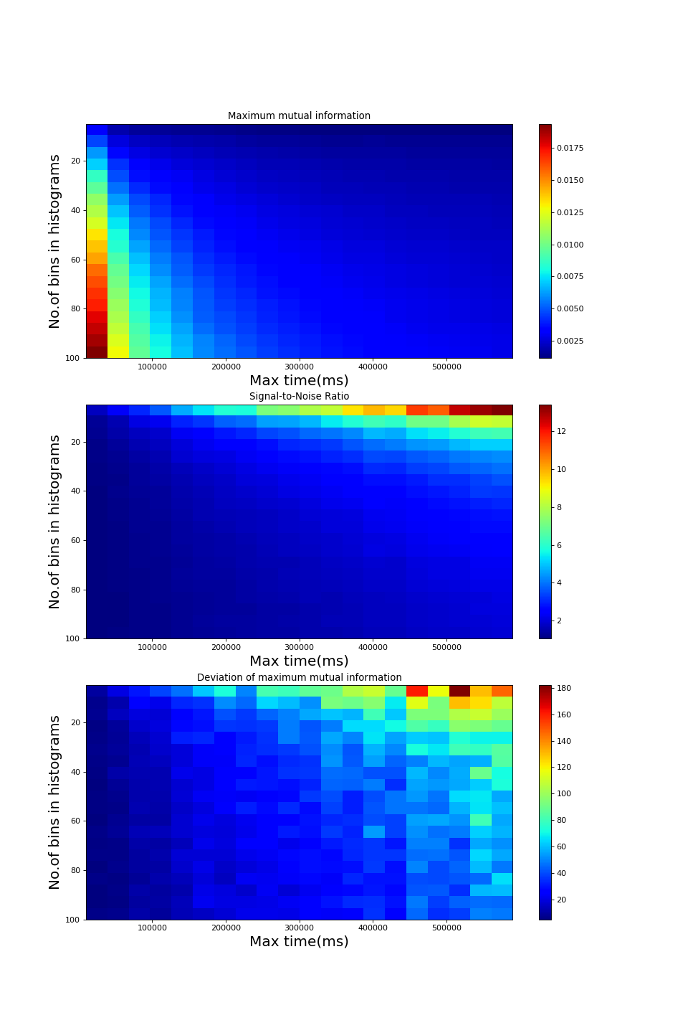
Autocovariance-based calculation with average
Find the autocovariance length of LFP, which is 20 ms here.
Break time series of LFP in pieces with length 20 ms, and treat all those pieces as a statistical ensemble.
Calculate the PDF at every time point in such 20 ms.
Do the same operates to the time series of binarized spike trains
For each time delay, calculate the mutual information between any possible combinations between spike train and LFP, and then take averages.
dt = 0.5 ms

Slide 18
Similarity of joint probability distribution function between different ensembles
Bivariate Two-sample Kolmogorov–Smirnov Test
X: Spike Train
Y: Current

Slide 19
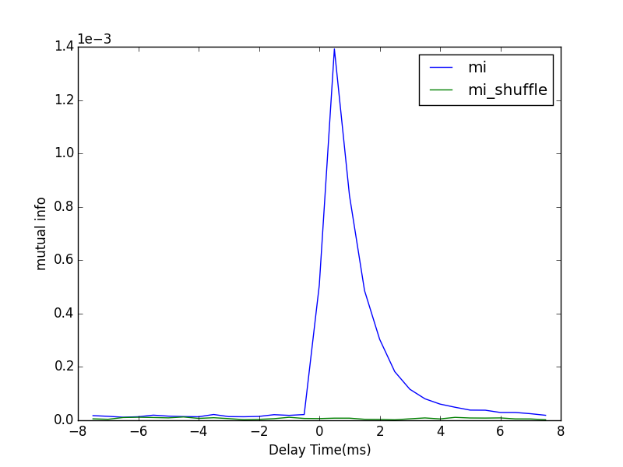
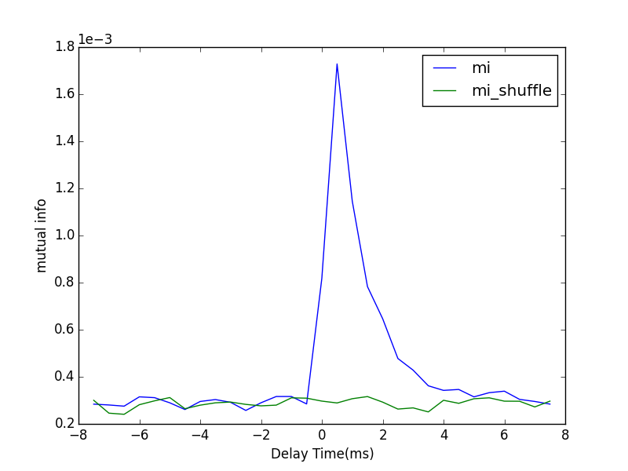
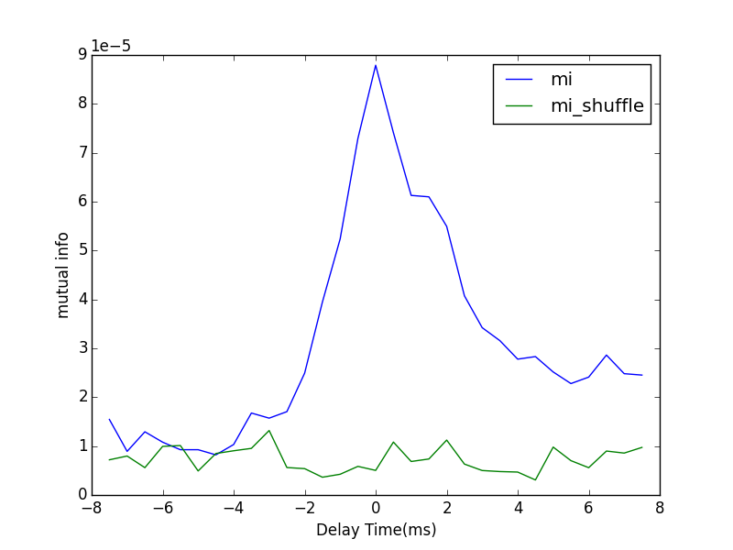
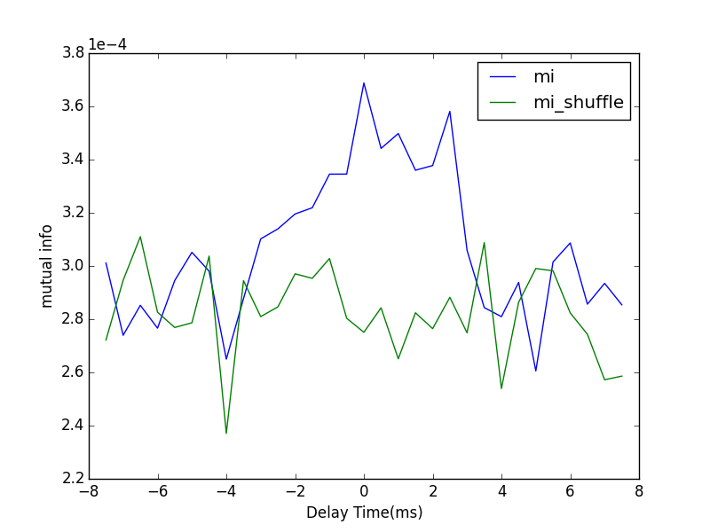
Mono-direction
Poisson Rate | 1.5 kHz
S | 0.005
F | 0.005
dt | 0.5 ms
#bins | 20
T | 59.5 s
direct
full
From 1 to 2
From 2 to 1

Slide 20
Neuronal interacting layout
Poisson
Poisson
Neuron 1
Spikes
Neuron 2
Spikes
Current
Current
Correlated!
Synchronized?
?

Slide 21
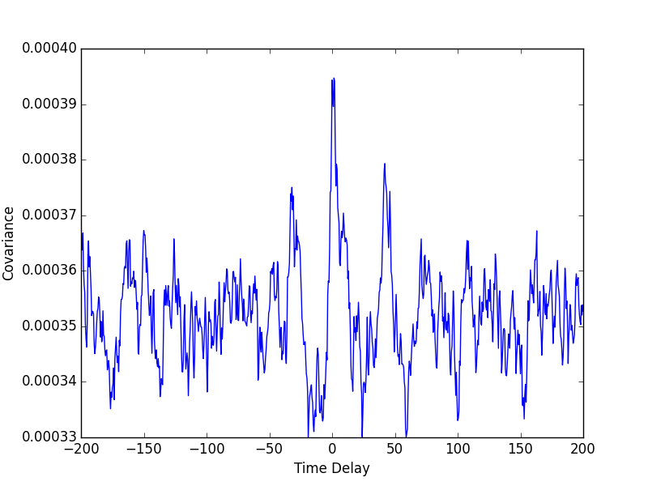
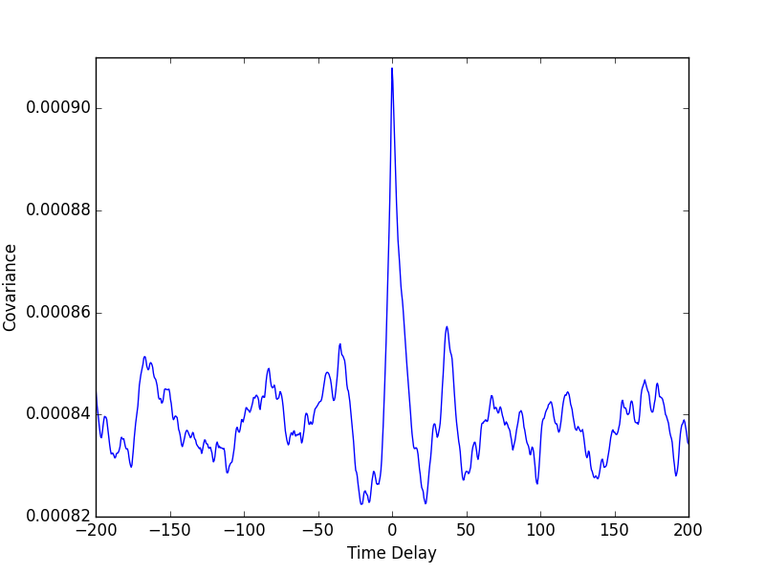
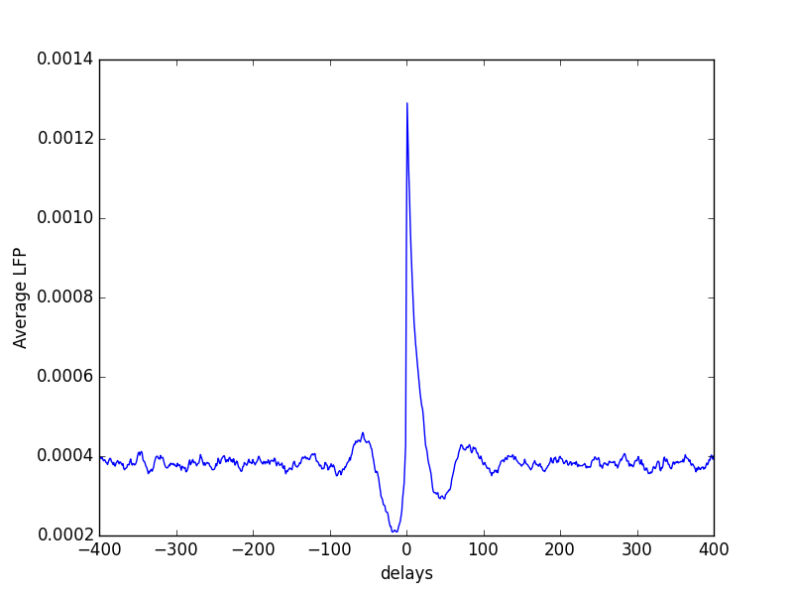
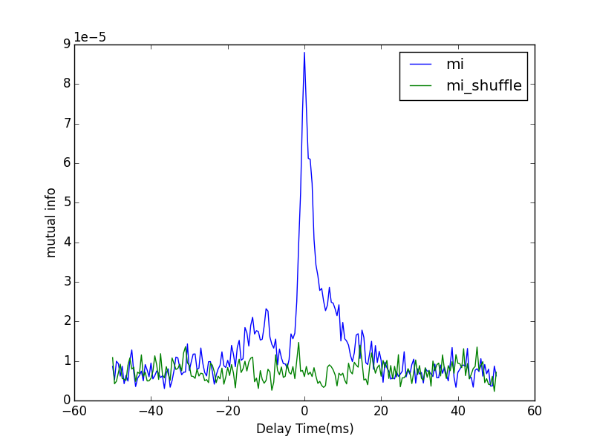
Poisson Rate | 1.5 kHz | dt | 0.5ms
S | 0.005 | #bins | 20
F | 0.005 | T | 10mins
Spike 2
to
Current 1
Current 2
to
Current 1
Spike 2
to
Current 2
Mutual info
Spike 2
to
Current 1

Slide 22
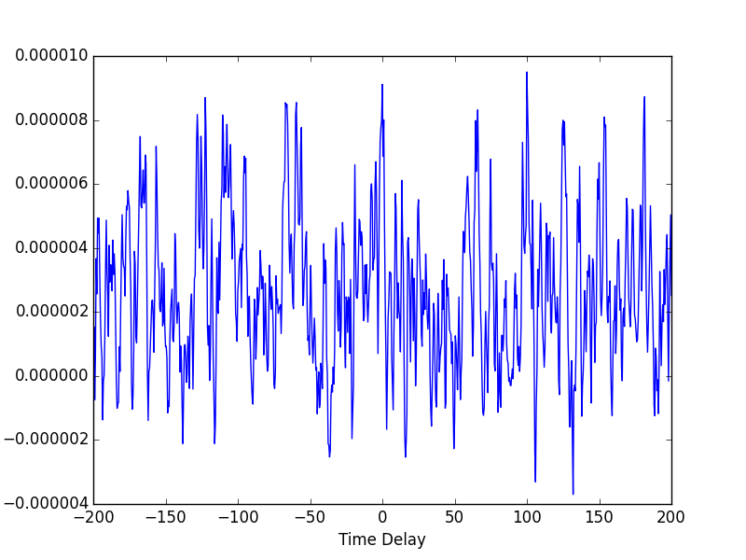
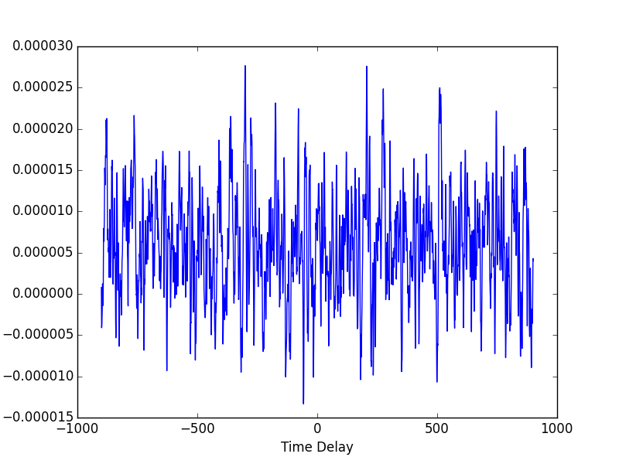
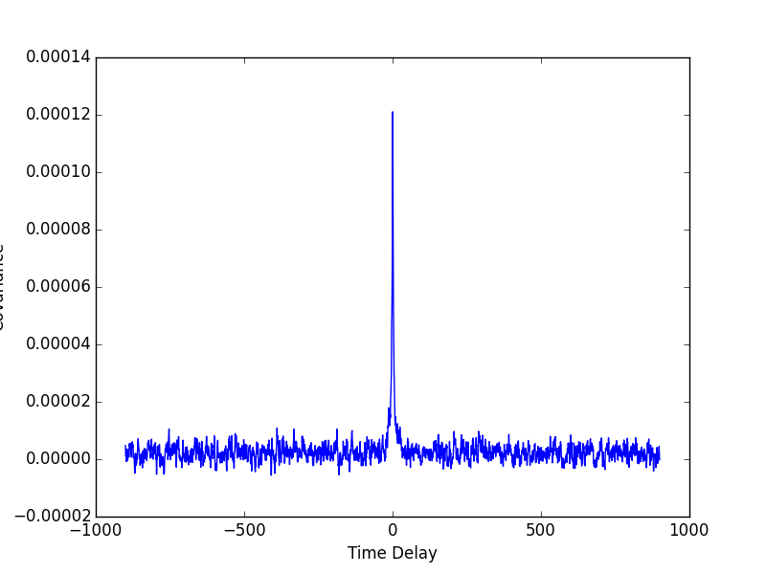
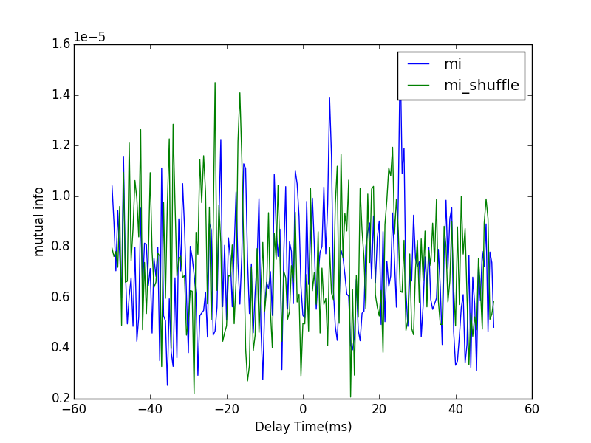
Poisson Rate | 0.1 kHz | dt | 0.5ms
S | 0.005 | #bins | 30
F | 0.030 | T | 10mins
Spike 2
to
Current 1
Current 2
to
Current 1
Spike 2
to
Current 2
Mutual info
Spike 2
to
Current 1

Slide 23
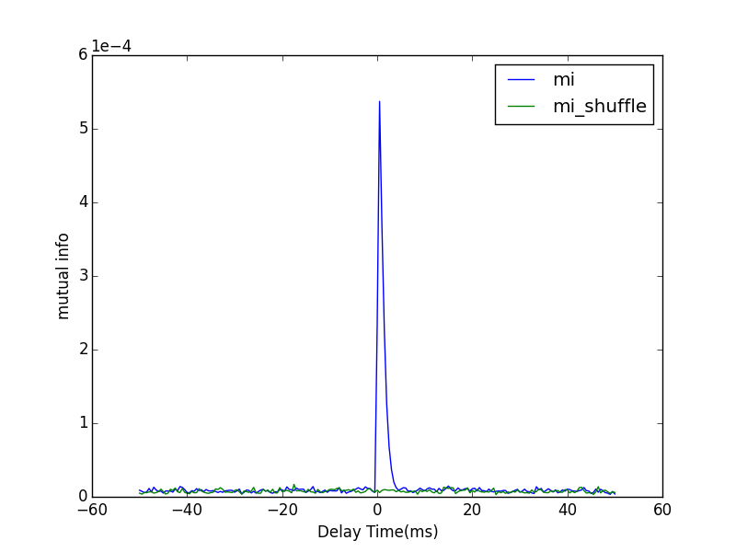
Poisson Rate | 0.1 kHz | dt | 0.5ms
S | 0.005 | #bins | 30
F | 0.030 | T | 10mins

Slide 24
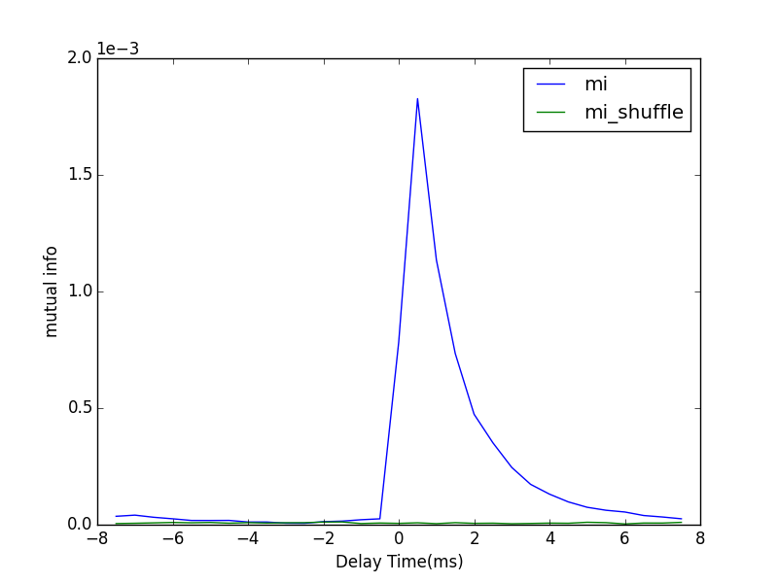
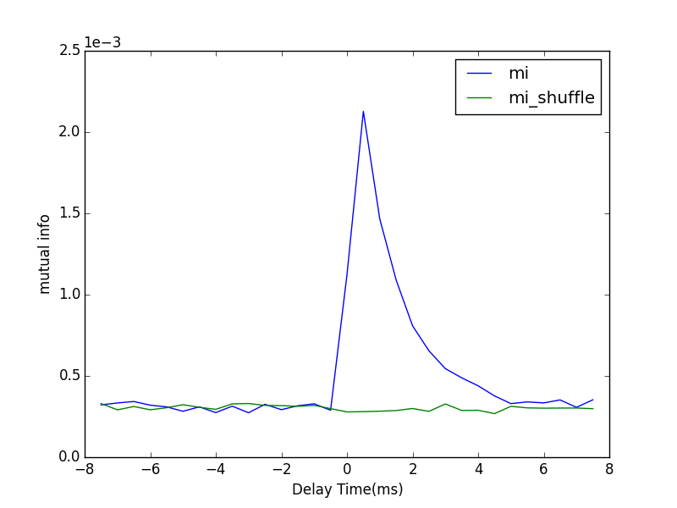
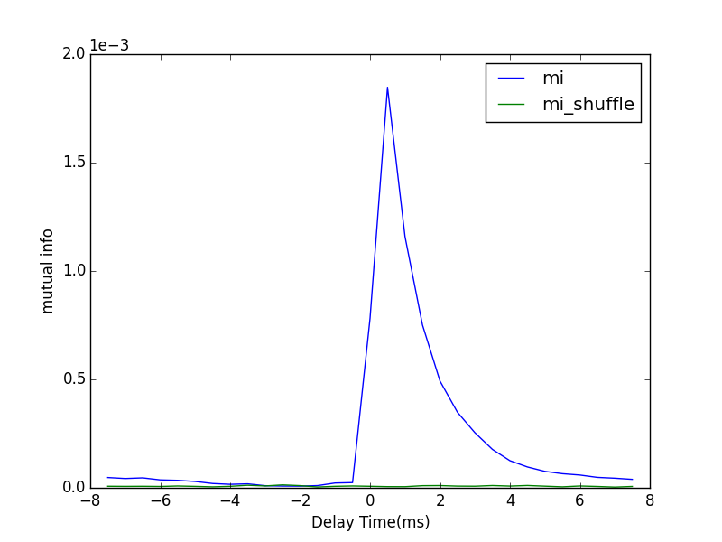
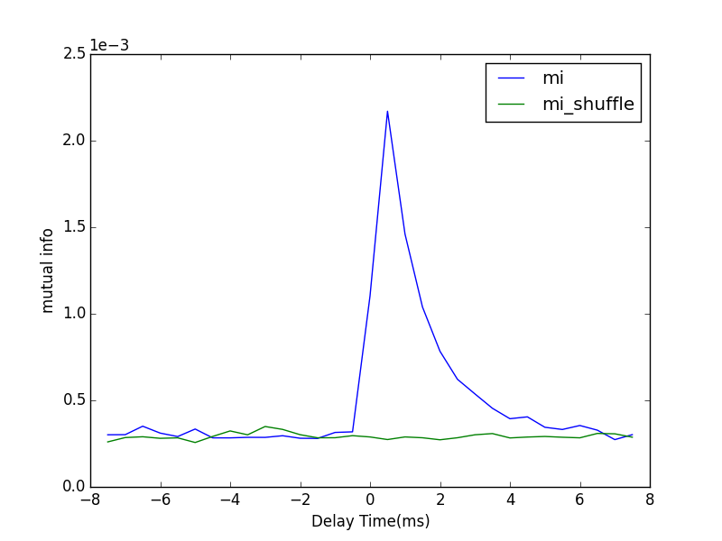
Bi-direction
Poisson Driving Rate | 1.5 kHz
Synaptic Strength | 0.005
Feedforward Strength | 0.005
direct
full
From 1 to 2
dt = 0.5 ms
#bins = 20
T = 59.5 s
From 2 to 1

Slide 25
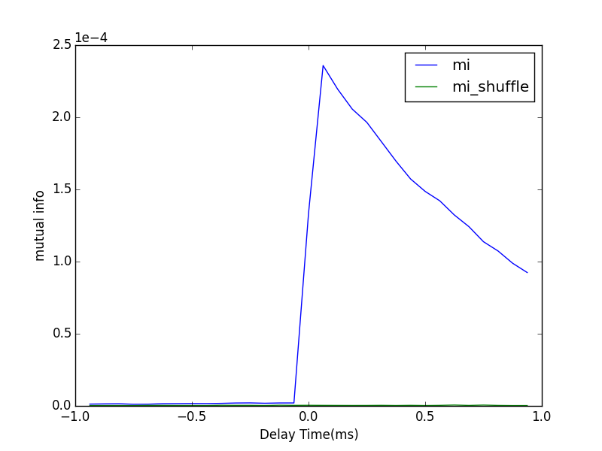
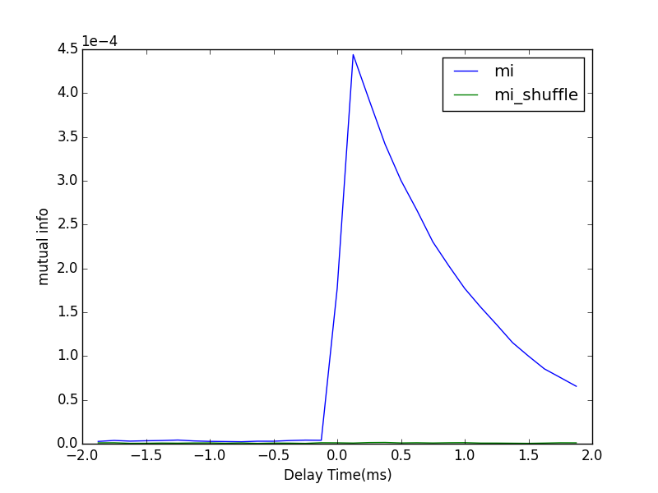
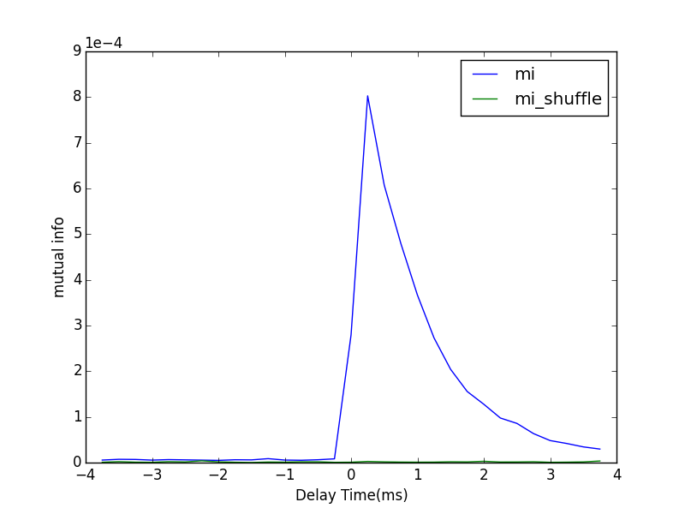
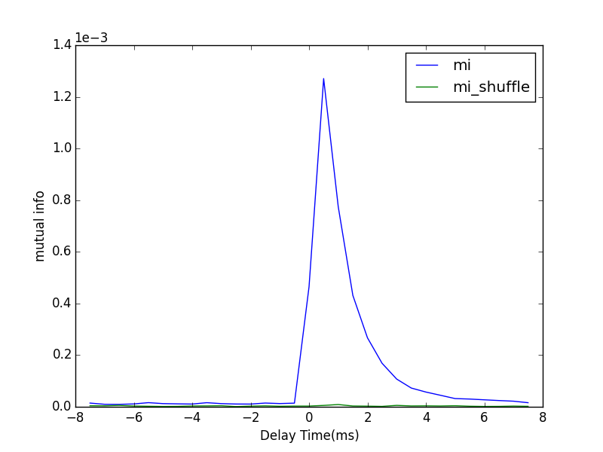
Different Timing Steps
0.0625ms
0.125ms
Poisson Rate | 1.5 kHz
S | 0.005
F | 0.005
#bins | 20
T | 59.5 s
Direct Method
0.25ms
0.5ms

Slide 26
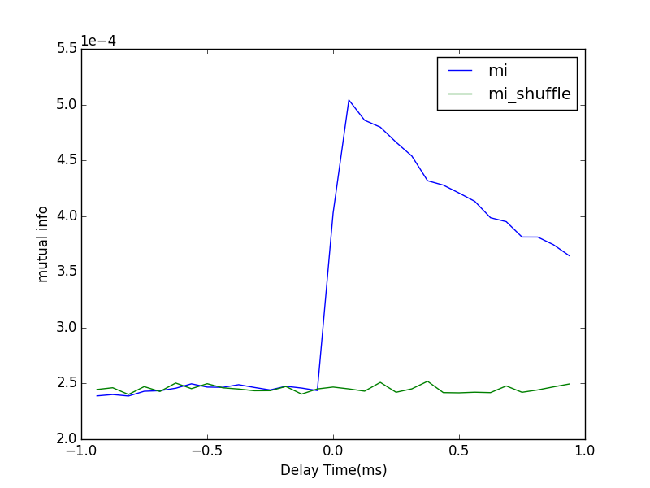
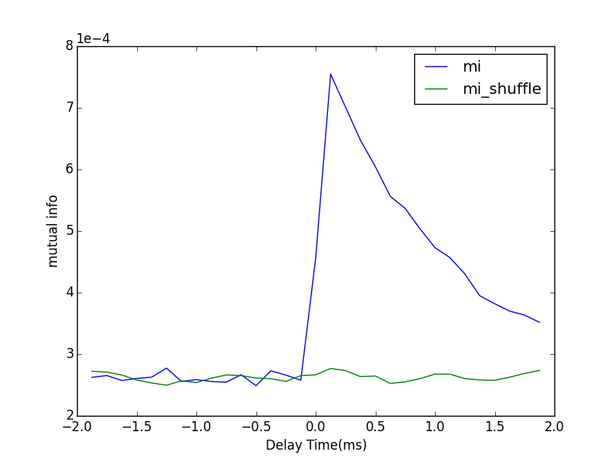
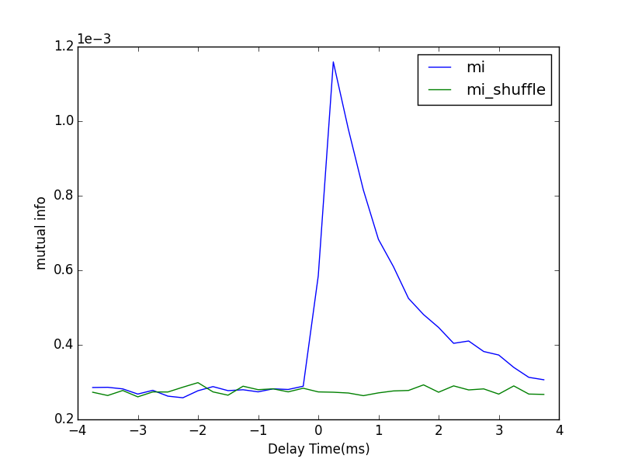
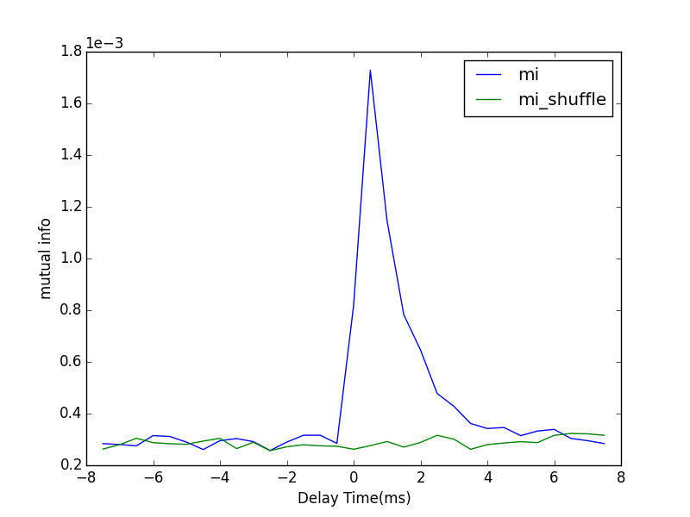
Different Timing Steps
0.0625ms
0.125ms
Poisson Rate | 1.5 kHz
S | 0.005
F | 0.005
#bins | 20
T | 59.5 s
Ensemble Method with average
0.25ms
0.5ms

Slide 27
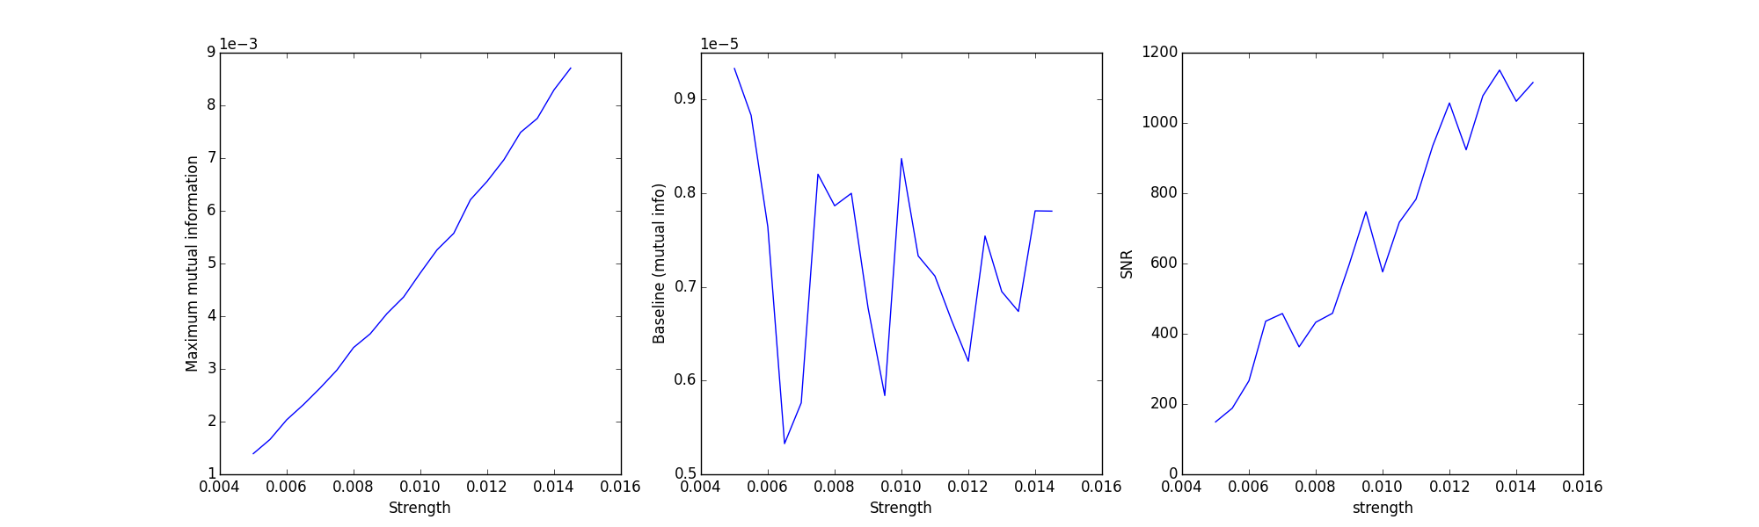
Direct calculation
Relation between synaptic strength and values of maximum mutual information
Synaptic strength ranging from 0.005 to 0.0145
Mean firing rate for presynaptic neuron is 10.5 Hz
Mean firing rate for postsynaptic neuron is ranging from 11Hz to 12.3 Hz
dt = 0.5 ms
#bins = 20
T = 59.5 s

Slide 28
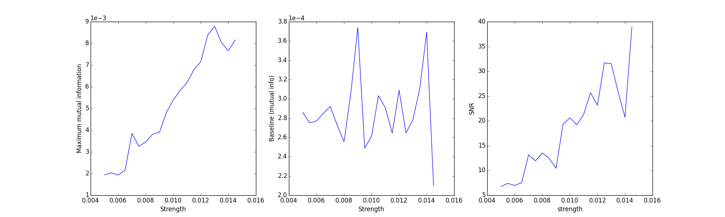
Autocovariance-based calculation without average
Cannot effectively calculate relationship between them even with small number of bins in histogram calculation

Slide 29
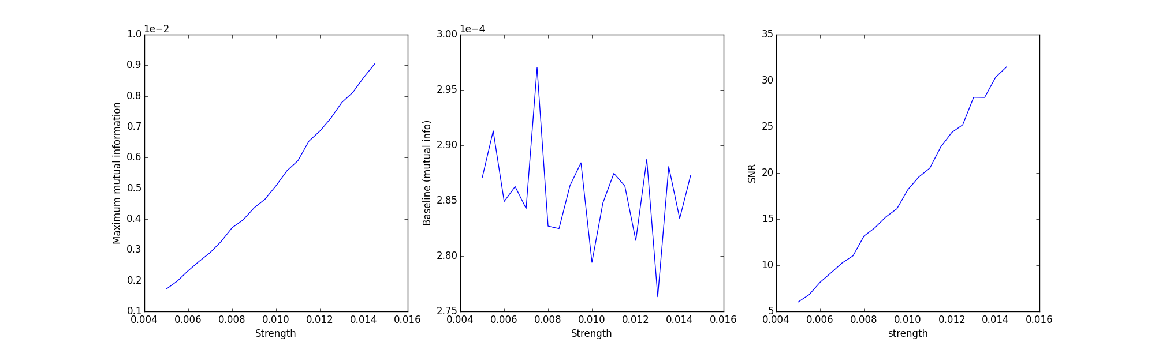
Autocovariance-based calculation with average

Slide 30
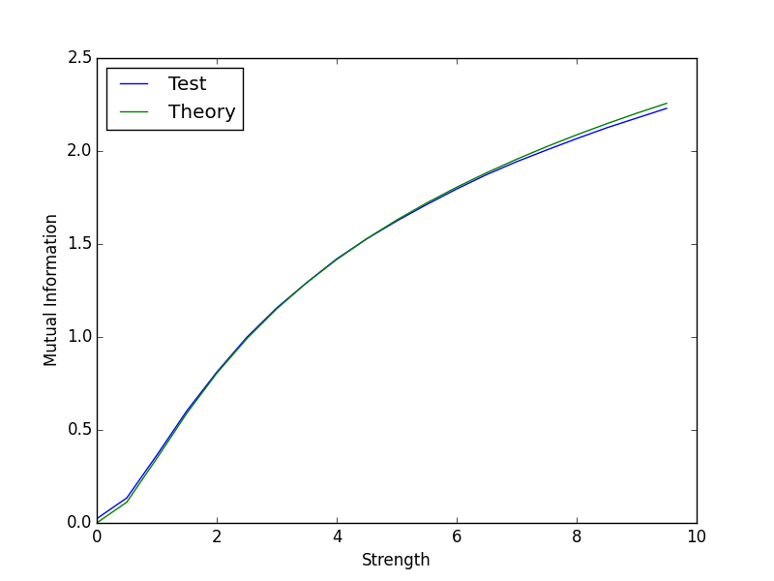







Mutual information of Gaussian random variables
$α=0.01，β=0.01$ #bin=50 T= 300000
$$X_{n}=αX_{n−1}+ε_{n}$$
$$Y_{n}=βY_{n−1}+ξX_{n−1}+η_{n}$$
$$I\left(X,Y\right)=H\left(X\right)+H\left(Y\right)−H(X,Y)$$
$$I\left(X,Y\right)=−\frac{1}{2}log⁡(1−ρ^{2})$$
$$ρ=ρ(ξ,α,β)$$
$α$ and $β$ are smaller than 1, suppose $n≫1$ ,
$${ρ(ξ)}^{2}=⁡\left\{\begin{aligned}\frac{ξ^{2}}{{(1−α^{2})}^{2}+ξ^{2}\left(1+α^{2}\right)} α=β \\ \frac{ξ^{2}(1−β^{2})}{{(1−αβ)}^{2}(1−α^{2})+ξ^{2}\left(1−{(αβ)}^{2}\right)} α≠β\end{aligned}\right.$$
#bins = 150 300000 trials

Slide 31








$α=0.6，β=0.01$ #bin=50 T= 300000
$α=0.01，β=0.6$ #bin=50 T= 300000
$α=0.6，β=0.5$ #bin=50 T= 300000
$α=0.5，β=0.6$ #bin=50 T= 300000

Slide 32


$α=0.5，β=0.5$ #bin=50 T= 300000

Slide 33







$α=0.01，β=0.01$ #bin=50 T= 300000
$α=0.01，β=0.01$ #bin=150 T= 300000
$α=0.6，β=0.01$ #bin=50 T= 300000
$α=0.6，β=0.01$ #bin=150 T= 300000

Slide 34







Triple-neuron system
1to2
2to3
1to3
2to1
3to2
3to1
Poisson Rate | 1.5 kHz
S | 0.005
F | 0.005
#bins | 20
T | 59.5 s
Ensemble Method

Slide 35




Spike and voltage
From 1 to 2
From 2 to 1

Slide 36
Coming Questions:
Why are the peaks of maximum for inversely directed pairs at zero?
It was induced by the synchronization of neuronal activities(currents).
Maximum mutual information seems independent towards the dynamical regime. [need further tests]
What is the relation between interacting strength and mutual information in the spike-LFP calculation? [It seems linear so far.]
Why does the curve of experiments change like that as the number of bins in histogram increases? [The higher is the dimension of histogram, the larger dataset is required to ensure the correctness.]

